Slide 1
JVM Architecture

Slide 2
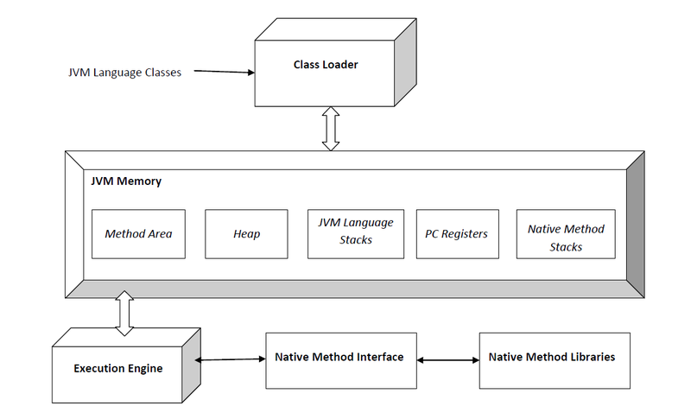

Slide 3
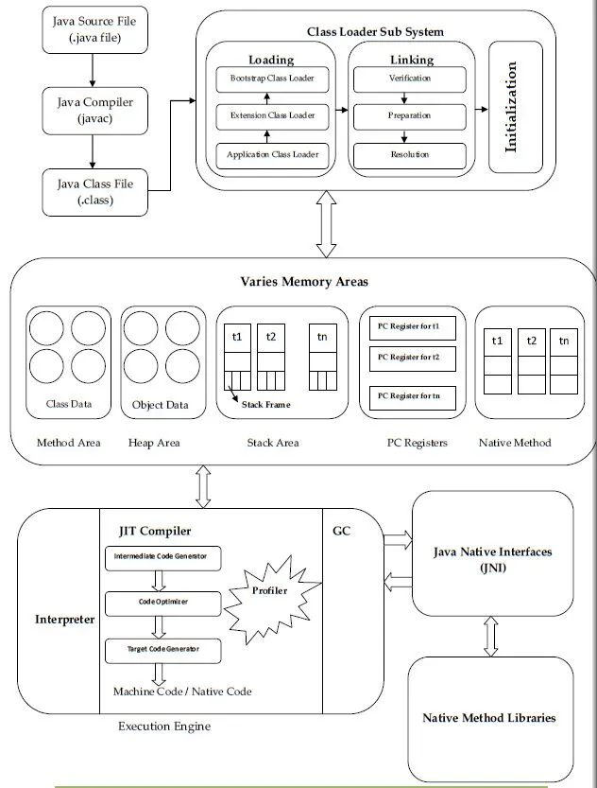

Slide 4
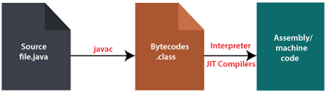
What is JVM ?
JVM (Java Virtual Machine) : It is an engine that provide runtime environment to lunch the Java application and responsible for converting the byte code (.class file) which generated by compiling the (.java file). JVM is a part of Java Runtime Environment(JRE).
Java applications are called WORA (Write Once Run Anywhere). This means a programmer can develop Java code on one system and can expect it to run on any other Java-enabled system without any adjustment. This is all possible because of JVM.

Slide 5
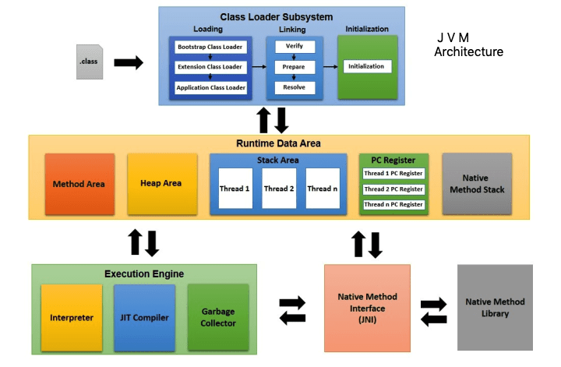

Slide 6
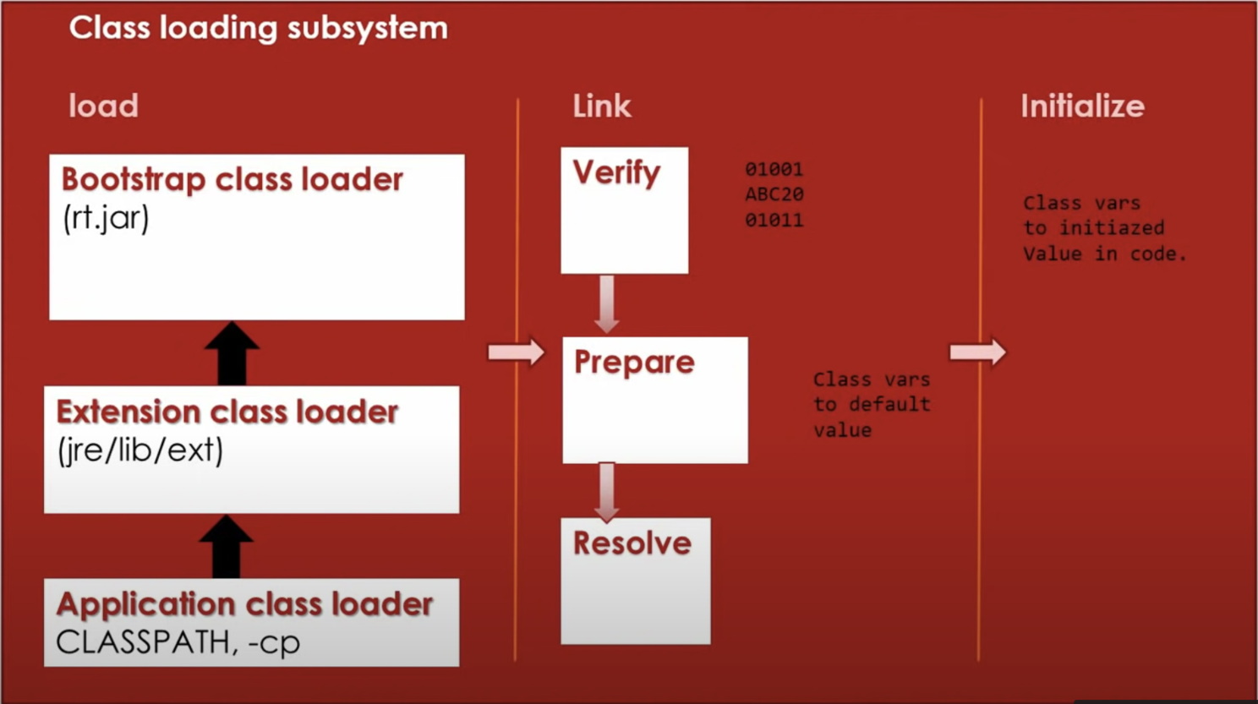
ClassLoader:
The ClassLoader is a part of the Java Runtime Environment (JRE) that dynamically loads Java class files from file system, network or any other source into the Java Virtual Machine. It have three main phases :
Loading
Linking
Initialization

Slide 7
Loading :
Is the part that responsible of loading the byte code (.class file) from various resources (e.g. file system, jar file, network socket) into memory.
The Load phase involve three different type of ClassLoader:
Bootstrap Class Loader: It loads JDK internal classes. It loads rt.jar and other core classes for example java.lang.* package classes.
Extensions Class Loader: It loads classes from the JDK extensions directory, usually $JAVA_HOME/lib/ext directory.
Application Class Loader: It loads classes from the current classpath. We can set classpath while invoking a program using -cp or -classpath command line option.

Slide 8
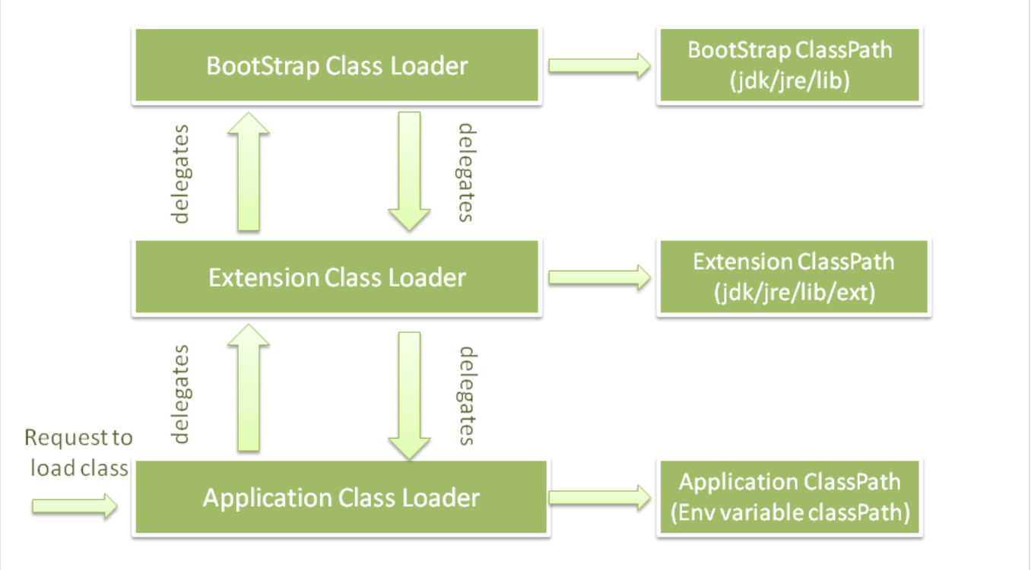
How ClassLoader works in Java !!

Slide 9
When JVM request for a class, it invokes a loadClass() method of the java.lang.ClassLoader class by passing the fully classified name of the class. The loadClass() method calls for findLoadedClass() method to check that the class has been already loaded or not. It is required to avoid loading the class multiple times.
If the class is not loaded, it delegates the request to parent ClassLoader to load the class. If the ClassLoader is not finding the class, it invokes the findClass() method to look for the classes in the file system. The following diagram shows how ClassLoader loads class in Java using delegation.
Suppose that we have an application specific class Student.class. The request for loading of this class files transfers to Application ClassLoader. It delegates to its parent Extension ClassLoader. Further, it delegates to Bootstrap ClassLoader. Bootstrap search that class in rt.jar and since that class is not there. Now request transfer to Extension ClassLoader which searches for the directory jre/lib/ext and tries to locate this class there. If the class is found there, Extension ClassLoader loads that class. Application ClassLoader never loads that class. When the extension ClassLoader does not load it, then Application ClaasLoader loads it from CLASSPATH in Java.
Visibility principle states that child ClassLoader can see the class loaded by the parent ClassLoader, but vice versa is not true. It means if Application ClassLoader loads Student.class, in such case, trying to load Student.class explicitly using Extension ClassLoader throws java.lang.ClassNotFoundException.

Slide 10
Linking :
It mainly have three phases:
Verification: It ensures the correctness of the .class file (bytecode) i.e. it checks whether this file is properly formatted and generated by a valid compiler or not and if that is compatible to the JVM class specification or not . If verification fails, we get run-time exception java.lang.VerifyError. This activity is done by the component ByteCodeVerifier. Once this activity is completed then the class file is ready for compilation.
Preparation: Memory is allocated for class variables and initialized to default values during preparation..
Resolution: This step involves replacing symbolic references with direct references. For example, resolving a method call to a specific method in a class.
Initialization: In this phase, the class’s static initializers and static blocks are executed. This is when the class is effectively “initialized.”
This is the final phase of Class Loading, here all static variables will be assigned with the original values, and the static block will be executed.

Slide 11
Method Area (Method Space):
The Method Area, also known as the Method Space, is a logical part of memory where the JVM stores class-level data and metadata.
It stores information about classes, such as field and method names, their data types, and access modifiers. This area also contains the runtime constant pool, which is a table of symbolic references to methods, fields, and other runtime constants.
The Method Area is shared among all threads and is a crucial part of maintaining Java’s type and method integrity.
This area is generally a fixed size, and it can trigger an OutOfMemoryError if it’s exhausted.

Slide 12
Heap:
The Heap is the runtime data area responsible for storing objects and their associated data. It is where the dynamic memory allocation for objects occurs.
The Heap is divided into two main regions: Young Generation and the Old Generation.
Young Generation: This is where new objects are created. It’s further divided into three regions:
Eden Space and two Survivor Spaces (S0 and S1). Objects are initially created in Eden Space.
When objects survive one or more garbage collection cycles, they may be promoted to the Survivor Spaces.
Old Generation (Tenured Generation): This area stores long-lived objects that have survived several garbage collection cycles in the Young Generation.
The garbage collector automatically manages the Heap to reclaim memory from no longer reachable objects. When the Heap is exhausted, it can lead to an OutOfMemoryError.

Slide 13
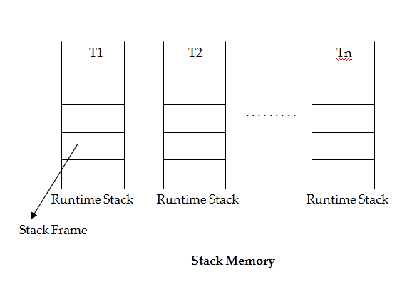
Stack Memory
For every thread JVM will create a runtime stack at the time of thread creation. Each and every method call performed by the thread and corresponding local variables will be stored by in the stack,
For every method call a separate entry will be added to the stack and each entry is called “Stack frame”
After completing the method call the corresponding entry will be removed from the stack. After completing the all method calls the stack will become empty and that empty stack will be destroyed by the JVM just before terminating the thread.or “activation record”.

Slide 14
Stack Frame Structure
Stack frame contains 3 parts
Local Variable Array
Operand Stack
Frame Data

Slide 15
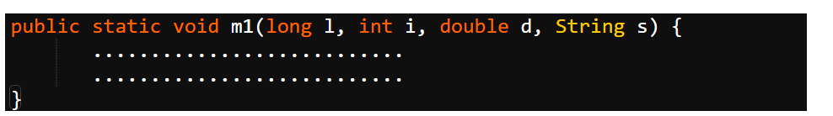
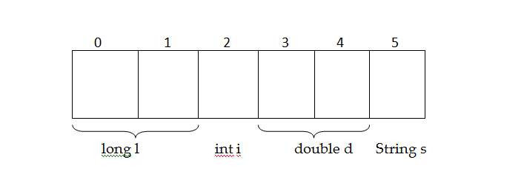
Stack Frame Structure(Local Variable Array)
It contains all parameters and local variables of the method.
Each slot in the array is of 4 bytes.
Values of type int, float and reference occupied 1 slot in array.
Values of type long, double occupied 2 consecutive entries in the array.
byte, short, char values will be converted to int type before storing and occupy one slot.
The way of storing boolean type is varied from JVM to JVM, but most of the JVM’s follow one slot for boolean values.

Slide 16
Stack Frame Structure(Operand Stack)
JVM uses operand stack as work space.
Some instructions can push the values to the operand stack and some instructions perform required operations and some instructions store results etc.
The operand stack follows the last-in first-out (LIFO) methodology.
For example, the iadd instruction adds two integers by popping two ints off the top of the operand stack, adding them, and pushing the int result. Here is how a Java virtual machine would add two local variables that contain ints and store the int result in a third local variable

Slide 17
Stack Frame Structure(Frame Data)
In addition to the local variables and operand stack, the Java stack frame includes data to support constant pool resolution, all symbolic references related to that method, normal method return, and exception dispatch.
This data is stored in the frame data portion of the Java stack frame. It also contains a referenced to exception table which contains corresponding catch block information in the case of exceptions. When a method throws an exception, the Java virtual machine uses the exception table referred to by the frame data to determine how to handle the exception.
Whenever the Java virtual machine encounters any of the instructions that refer to an entry in the constant pool, it uses the frame data’s pointer to the constant pool to access that information.

Slide 18
PC Registers (Program Counter Registers)
For every thread a separate PC register will be created at the time of thread creation. PC register contains address of current executing instruction. Once instruction execution completes automatically PC register will be incremented to hold address of next instruction. An “address” can be a native pointer or an offset from the beginning of a method’s byte codes.

Slide 19
Native Method Stacks
Here also for every Thread a separate run time stack will be created. It contains all the native methods used in the application. Native method means methods written in a language other than the Java programming language. In other words, it is a stack used to execute C/C++ codes invoked through JNI (Java Native Interface). According to the language, a C stack or C++ stack is created.

Slide 20
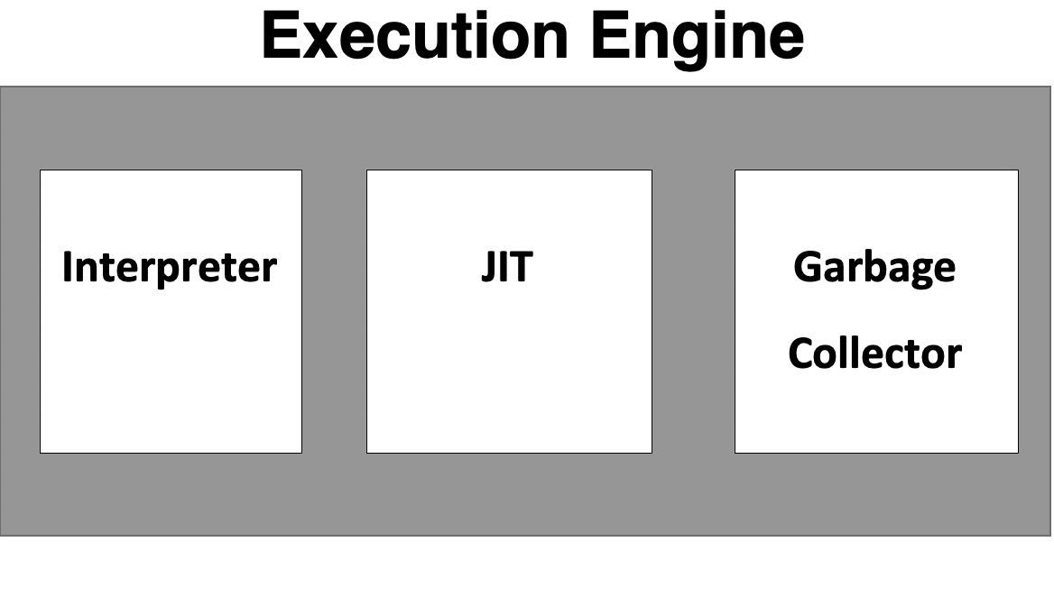
Execution Engine handles this by executing the code present in each class . However, before executing the program, the bytecode needs to be converted into machine language instructions. The JVM can use an interpreter or a JIT compiler for the execution engine.

Slide 21
Execution Engine
It can be classified into three parts:
3.1 Interpreter :The interpreter reads and executes the bytecode instructions line by line. Due to the line by line execution, the interpreter is comparatively slower.
Another disadvantage of the interpreter is that when a method is called multiple times, every time a new interpretation is required.
3.2 Just-In-Time Compiler(JIT) : It is used to increase the efficiency of an interpreter. It compiles the entire bytecode and changes it to native code so whenever the interpreter sees repeated method calls, JIT provides direct native code for that part so re-interpretation is not required, thus efficiency is improved.
3.3 Garbage Collector: It destroys un-referenced objects. For more on Garbage Collector, refer Garbage Collector.

Slide 22
Java Native Interface (JNI) Native Method Libraries :
Java Native Interface (JNI) :
It is an interface that interacts with the Native Method Libraries and provides the native libraries(C, C++) required for the execution. It enables JVM to call C/C++ libraries and to be called by C/C++ libraries which may be specific to hardware.
Native Method Libraries :
It is a collection of the Native Libraries(C, C++) which are required by the Execution Engine.

